Slide 1

Part II-Software Testing
Functional Testing
Lecture # 16, 17, 18

Slide 2
Today’s Outline
Functional testing
Boundary value analysis
Equivalence class testing
Decision table based testing
Revision
Notes:
Exam questions
https://www.toolsqa.com/software-testing/istqb/decision-table-testing/

Slide 3
Robustness testing (BVA)
This is the extension of boundary value analysis.
Here, we also select invalid values and see the responses of the program.
Thus, the total test cases in robustness testing are 6n + 1,
Minimum value
Just above minimum value
Just below minimum value
Just above maximum value
Just below maximum value
Maximum value
Nominal (Average) value

Slide 4
Practice Problem:
Consider the program for the determination of division of a student based on marks obtained in three subjects as explained in example 2.2. Design the robust test cases.

Slide 5
Worst-case Testing(BVA)
This is a special form of boundary value analysis where we don’t consider the ‘single fault’ assumption theory of reliability.
The restriction of one input value at any of the above mentioned values and other input values must be at nominal is not valid in worst-case testing.
This will increase the number of test cases from 4n + 1 test cases to 5n test cases.

Slide 6
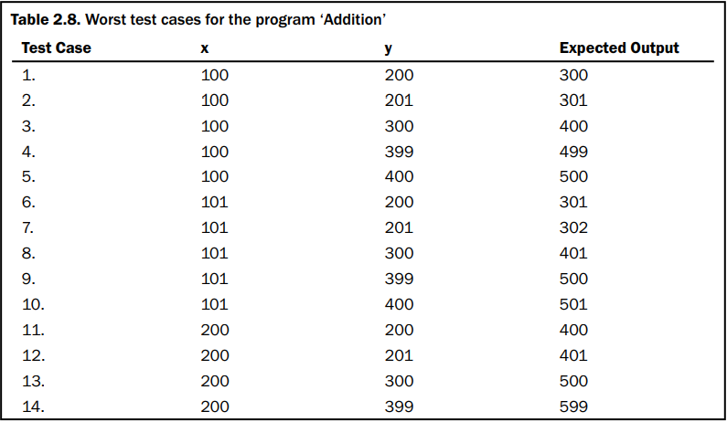
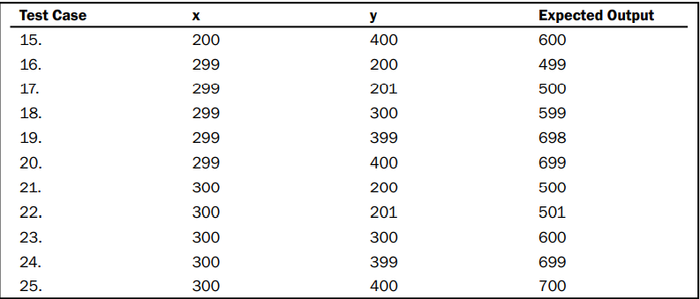
Example:
The range of both input values are given as: 100 <=x<= 300 200 <= y<= 400

Slide 7
robustness
This is a more comprehensive technique.
This requires more effort and is recommended in situations where failure of the program is extremely critical and costly.

Slide 8
EQUIVALENCE CLASS TESTING
A large number of test cases are generated for any program. It is neither feasible nor desirable to execute all such test cases.
Divide input domain into various categories with some relationship and expect that every test case from a category exhibits the same behavior.
If categories are well selected, we may assume that if one representative test case works correctly, others may also give the same results..
Each category is called an equivalence class and this type of testing is known as equivalence class testing.
Notes:
Many test cases do not test any new thing and they just execute the same lines of source code again and again.

Slide 9
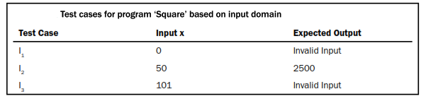

Creation of Equivalence Classes
The entire input domain can be divided into at least two equivalence classes: one containing all valid inputs and the other containing all invalid inputs.
Each equivalence class can further be sub-divided into equivalence classes on which the program is required to behave differently.
Square program

Slide 10
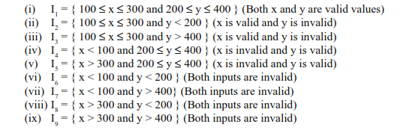
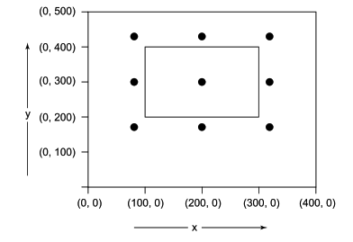
equivalence classes for addition program

Slide 11
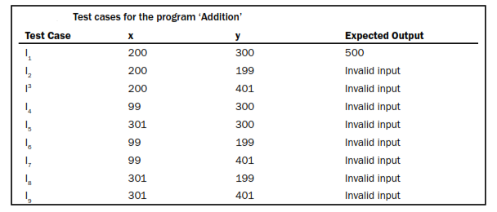
Test cases for addition

Slide 12
applicability
Applicable at unit, integration, system and acceptance test levels.
The basic requirement is that inputs or outputs must be partitioned based on the requirements and every partition will give a test case.
If one test case catches a bug, the other probably will too.
The design of equivalence classes is subjective to testing person.

Slide 13
Example
Consider a program for the determination of the largest amongst three numbers. Its input is a triple of positive integers (say x, y and z) and values are from interval [1, 300].
Design the equivalence classes

Slide 14
DECISION TABLE BASED TESTING
In Software Engineering, boundary value and equivalent partition are other similar techniques used to ensure better coverage.
However, in a system where for each set of input values the system behavior is different, boundary value and equivalent partitioning technique are not effective in ensuring good test coverage.
In this case, decision table testing is a good option. This technique can make sure of good coverage, and the representation is simple so that it is easy to interpret and use.

Slide 15
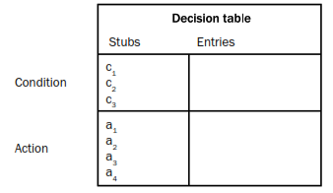
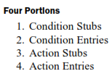
DECISION TABLE BASED TESTING
An output may be dependent on many input conditions and decision tables give a pictorial view of various combinations of input conditions.
There are four portions of the decision table.

Slide 16
Parts of the Decision Table
The four parts of the decision table are given as:
Condition Stubs: All the conditions are represented in this upper left section of the decision table. These conditions are used to determine a particular action or set of actions.
Action Stubs: All possible actions are listed in this lower left portion of the decision table.
Condition Entries: In the condition entries portion of the decision table, we have a number of columns and each column represents a rule.
Action Entries: Each entry in the action entries portion has some associated action or set of actions in this lower right portion of the table.

Slide 17
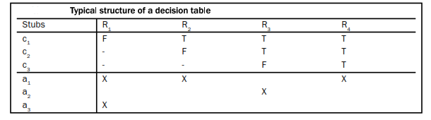
Typical structure of decision table

Slide 18
Example:
Consider a program for the determination of the largest amongst three numbers. Its input is a triple of positive integers (say x,y and z) and values are from interval [1, 300]. Design the test cases using decision table testing.

Slide 19
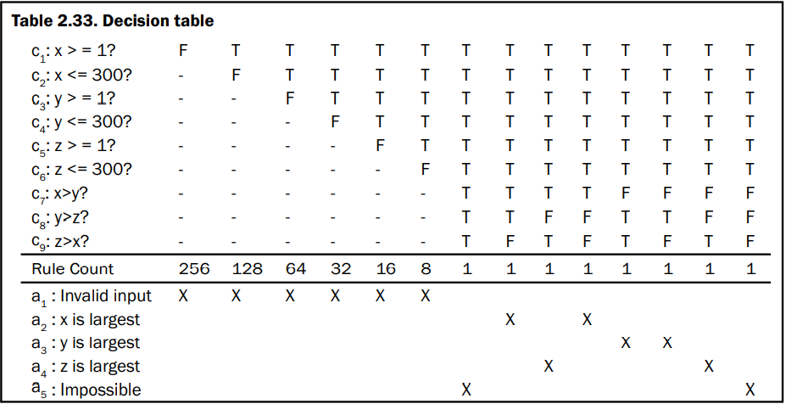
Example:
Do Not Care’ Conditions and Rule Count

Slide 20
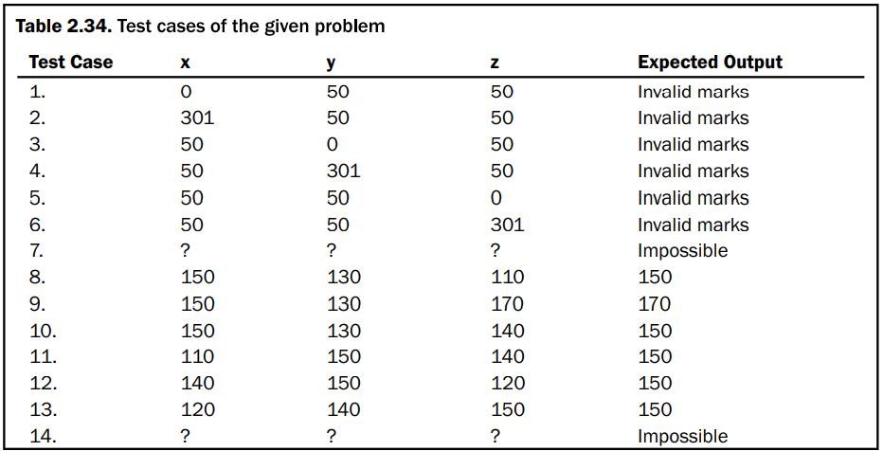
Example:

Slide 21
decision table for a login screen.
The condition is simple if the user provides correct username and password the user will be redirected to the homepage. If any of the input is wrong, an error message will be displayed.
Case 1 – Username and password both were wrong. The user is shown an error message.
Case 2 – Username was correct, but the password was wrong. The user is shown an error message.
Case 3 – Username was wrong, but the password was correct. The user is shown an error message.
Case 4 – Username and password both were correct, and the user navigated to homepage

Slide 22
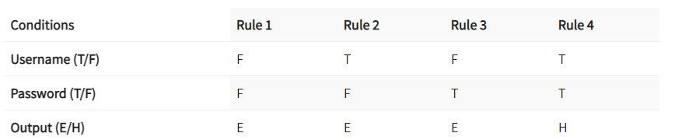
Notes:
Activity : any example of decision table

Slide 23
applicability
Decision tables are popular in circumstances where an output is dependent on many conditions and a large number of decisions are required to be taken.
They may also incorporate complex business rules and use them to design test cases.
Every column of the decision table generates a test case.
As the size of the program increases, handling of decision tables becomes difficult and cumbersome.
In practice, they can be applied easily at unit level only. System testing and integration testing may not find its effective applications.

Slide 24
applicability
It's a tabular representation of input conditions and resulting actions. Additionally, it shows the causes and effects. Therefore, this technique is also called a cause-effect table.
Testing combinations can be a challenge, especially if the number of combinations is enormous. Moreover, testing all combinations is not practically feasible as it's not cost and time effective. Therefore, we have to be satisfied with testing just a small subset of combinations. That is to say, the success of this technique depends on our choice of combinations

Slide 25
That is all

